Slide 1
Updated Plots for BNB with NuMI Phase Space

Slide 2
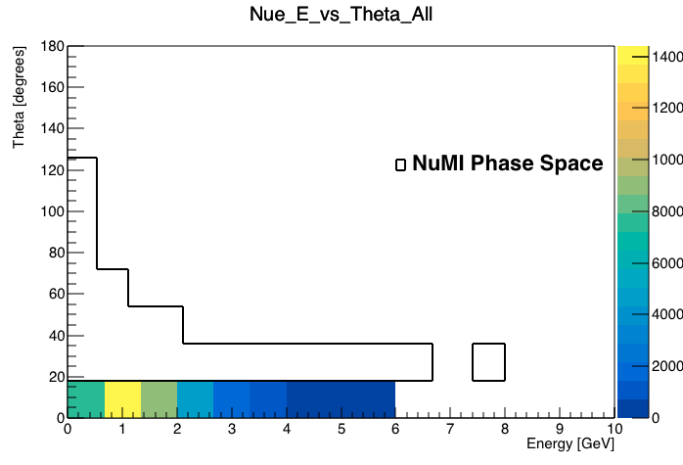
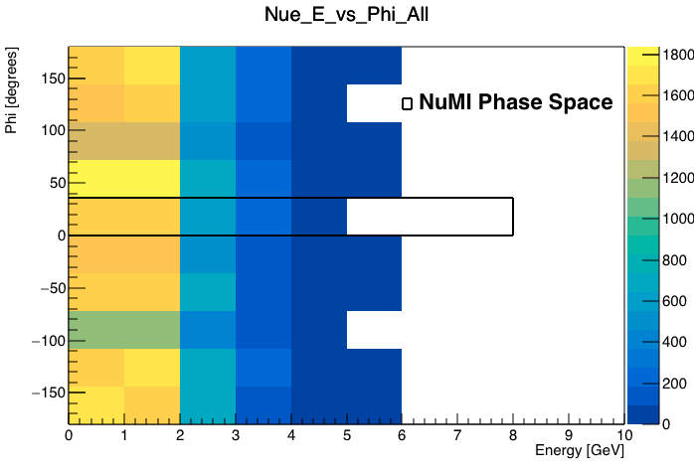
Nue

Slide 3
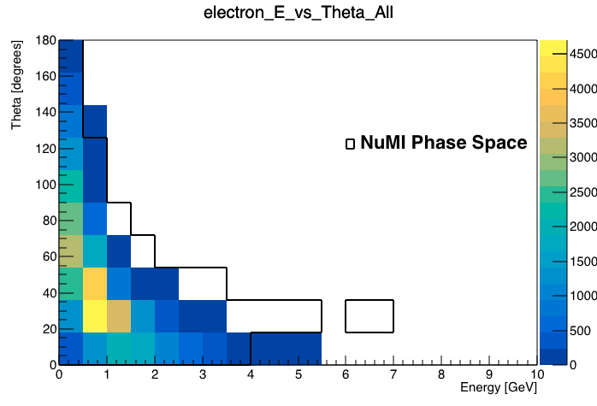
Electrons
I messed up on Phi (forgot to convert rad to degrees -_-)

